Slide 1
GraduatE study
Department of Computer Science and Engineering

Slide 2
CSE Graduate Programs
MS Degrees
MS in Computer Science
MS in Computer Science (Computer Engineering Specialization)
MS in Computer Science (Bioinformatics Specialization)
PhD Degrees
PhD in Computer Science
PhD in Engineering (Computer Engineering Specialization)
PhD in Computer Science (Bioinformatics Specialization)
Joint PhD in Computer Science & Mathematics

Slide 3
Rankings
NRC rankings provided by PhDs.org highlights some of our strengths
5th for Diversity
9th for “smaller programs”
25th for “larger programs”
13th for “programs with more female students & faculty
16th for “programs with more minority students & faculty
7th for “programs with lower tuition”
17th for “programs with more funded students”

Slide 4
CSE Core Areas
Software Engineering
Software Testing and Reliability, Methodology, Maintenance, Program Analysis
Systems
Embedded Systems, Sensors and Sensor Networks, Cyber-Physical Systems, Robotics
Informatics, Theoretical Foundations
Data Mining, Databases, Bioinformatics, Computer Vision, Simulation and Modeling, Machine Learning, Algorithms

Slide 5
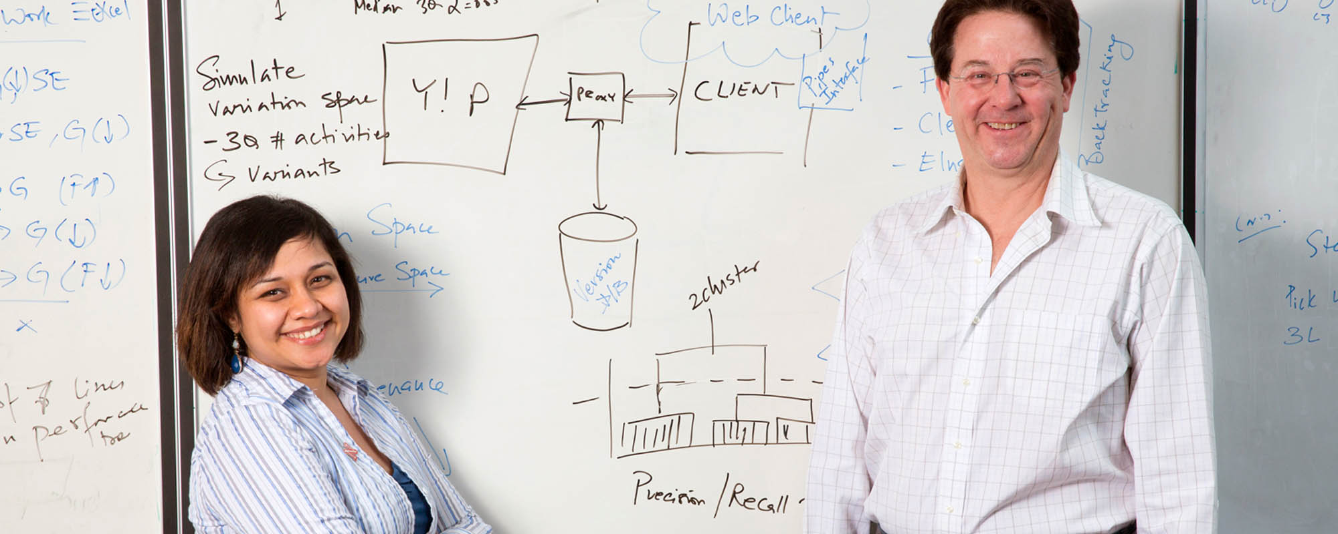
CSE Faculty
40 Faculty
Full Professors = 14
Associate Professors = 11
Assistant Professors = 7
Research Professors = 2
Professor of Practice = 4
Lecturers = 2
Ten faculty have won NSF CAREER awards
Four named professorships, 2 distinguished scholars
IEEE Fellow

Slide 6
Admission Requirements
Depends on many factors:
Areas of interest
Recommendation letters
Statement of purpose
Qualifications of other applicants
Students admitted…
Typically come with a background in CS or CE
Have an academic record including:
Ability to conduct independent work
A grade point average of at least 3.0/4.0 (B) or better
http://cse.unl.edu/graduate-admission-requirements

Slide 7
Financial Support
Most of our Graduate Students get paid to go to school!
Teaching Assistant
Teach, grade, etc.
You apply to the department
Research Assistantship
Work on a research project
You apply to a professor
External Fellowship
Sponsored by external sources (e.g. NSF)
You apply to agency
Competitive. Helps if you have strong interest in research and indicate which professors you’d like to work with in your SoP
Typically $18,000-$19,000/year + tuition + health insurance
Depends on your status in the program (MS, PhD candidate, etc.)

Slide 8
Student Exchange
Faculty-led
Attend courses developed, taught, and let by UNL faculty member(s)
Register for and receive UNL course credits and grades just like an on-campus course in a foreign institution
UNL Partner Universities (Bilateral Exchanges)
Based on agreements between a host university and UNL for a reciprocal exchange of students and scholars

Slide 9
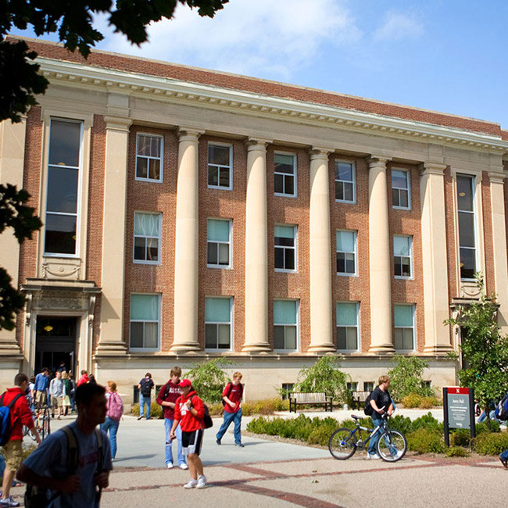
Facilities– Avery Hall
The CSE Department is housed in Avery Hall, which reopened in 2004 after a complete renovation. Avery’s academic elegance coupled with state-of-the-art classrooms make it a comfortable home for the department. Administrative offices and the Department Chair are located in Avery Hall, Room 256

Slide 10
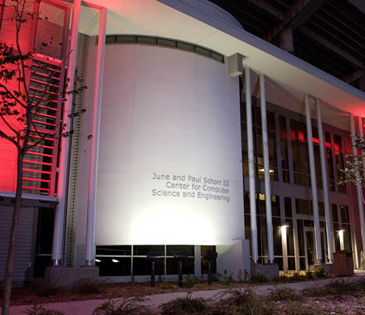
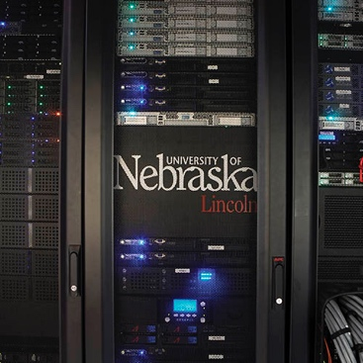
Facilities–
June & Paul Schorr III Center for Computer Science and Engineering Research
The June & Paul Schorr III center for Computer Science and Engineering Research houses the majority of the Systems faculty, their research labs, graduate assistants, and some administrative staff
It also houses the Holland Computing Center which has the fastest computing resources in the state
The June and Paul Schorr III Center for Computer Science and Engineering Research was made possible by a generous donation from Chip Schorr in honor of his parents who are graduates and long-time supporters of the University.

Slide 11
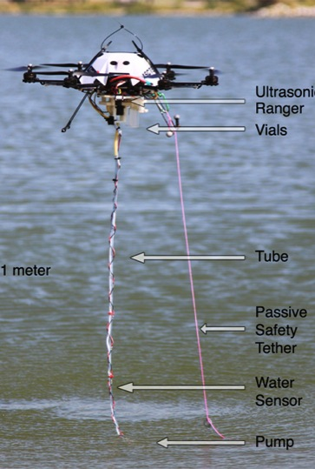
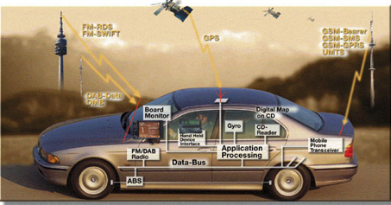

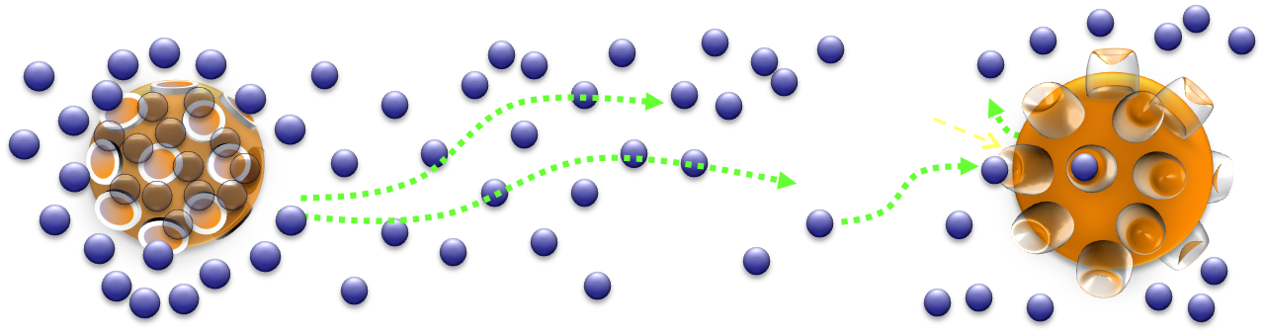
Research Opportunities (Systems Area)
Aerial Robots (UAVs), underwater sensors, sensor nets, human-Robot Interaction
Resource Management for Cluster Computing
Biological and Molecular Communication Networks
Future Internet, optical and wireless networks, network security and telecommunications
Advanced Runtime Systems
Underground Sensor Networks, Track Crane Migration
Hardware, Software, User Experience Security
Transport Protocols for Internet Applications
Cyber Security and Threat Intelligence
Large Data Visualization

Slide 12
Systems Faculty
Justin Bradley: Cyber-Physical Systems, CubeSats, aerial robotics
Carrick Detweiler: Aerial robotics, underwater sensors, field robotics
Brittany Duncan: Human-Robot Interaction, telepresence robots, aerial robotics
Sebastian Elbaum: Software Engineering, verification and validation, aerial robotics
Ying Lu: Real-time systems, autonomic computing, grid computing
Massimiliano Pierobon: Molecular communication, bio-networks
Byrav Ramamurthy: Optical, peer-to-peer, multimedia streaming, net security
Witty Srisa-an: Memory management, OO systems, virtual machines
David Swanson: Scientific computing, cluster, molecular dynamics, monte carlo
Mehmet Can Vuran: Wireless sensor nets, cognitive radio nets, underground sensors
Sheng Wei: Hardware security, Hardware Secure Experience Lab (HWSEL)
Lisong Xu: Networking protocols and architectures
Qiben Yan: Wireless network security, malware detection, data-driven secure networks, THINK lab
Hongfeng Yu: Data analysis, visualization, high-perf computing, user interfaces

Slide 13
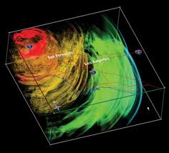
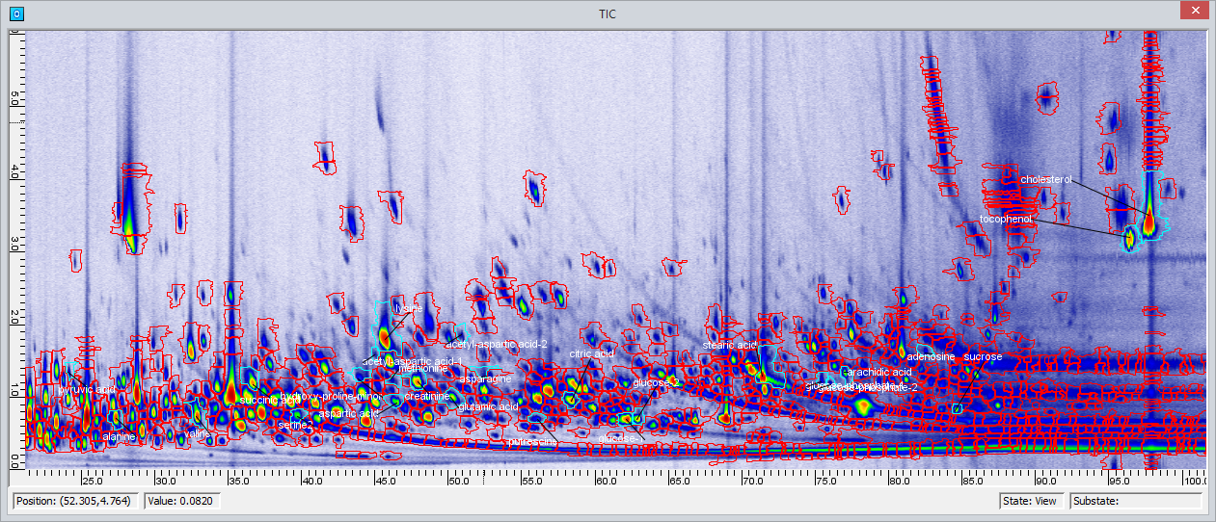



Research Opportunities (IAF Area)
Image understanding
Data mining
Big data analysis and visualization
Abstraction, reformulation, and approximation
Constrained reasoning and constraint satisfaction
Machine learning
Bioinformatics, Biomedical informatics
Multiagent systems: team formation, active sensing, intelligent agents
Computer science education
Image processing from chromatography and mass spectrometry

Slide 14
IAF Faculty
Ashok Samal: image understanding, spatial data mining
Hongfeng Yu: large data analysis and visualization, user interfaces and interaction, and computer graphics
Berthe Choueiry: dynamic symmetry detection and exploitation, scheduling and resource allocation, constraint processing and satisfaction
Stephen Scott: machine learning, bioinformatics
Juan Cui: biomedical informatics, machine learning and data mining algorithms
Leen-Kiat Soh: multiagent systems, computer science education, survey informatics
Stephen Reichenbach: image processing and analysis from chromatography and mass spectrometry

Slide 15
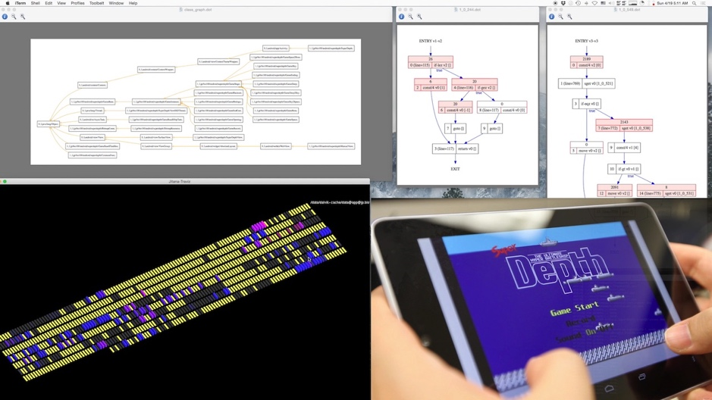
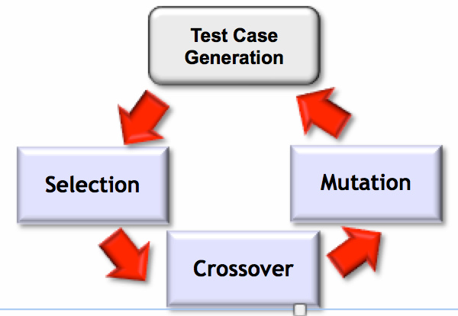
Research Opportunities (SE Area)
Search-based Software Engineering
Dynamic inference of rich program specifications.
Quantitative software analysis
Design of complex software systems through tradeoff analysis and synthesis
Verification of parallel scientific codes
Security analysis and testing of mobile software
Validating software at scale (billions of tests, thousands of devs)

Slide 16
SE Faculty
Hamid Bagheri: system modeling and analysis for security; design-space exploration
Myra Cohen: combinatorial interaction testing of highly-configurable systems; validating engineered biological systems
Matthew Dwyer: program analysis, specification, and verification
Sebastian Elbaum: software testing at scale, engineering robust cyber-physical system software
Brady Garvin: analysis of software product lines, SE education
ThanVu Nguyen: program repair, synthesis, and verification; dynamic specification inference
Suzette Person: longitudinal program analysis and testing, SE education
Gregg Rothermel: software evolution, regression testing, empirical studies

Slide 17

Choose Nebraska
Get paid while you learn
Many students receive teaching research assistantships, which include
payment of tuition and health insurance
Study on the cutting edge
Get involved in nationally funded research projects and learn with and
develop new technology
Work with professors one-on-one
We’ll help you to deeper into topics what were covered more generally in undergraduate coursework. Many graduate courses are project-based – you do independent projects, read research papers and run experiences
Obtain marketable skills
Attending graduate school will help you obtain highly marketable skills that will launch you into a professional career and a lifetime of exciting opportunities
Live in Lincoln!
UNL is located in an up-and-coming and safe city of 250,000 people that has many cultural and entertainment benefits of a much larger city, with the feel of a friendly Midwestern community
unl.edu/lincoln

Slide 18
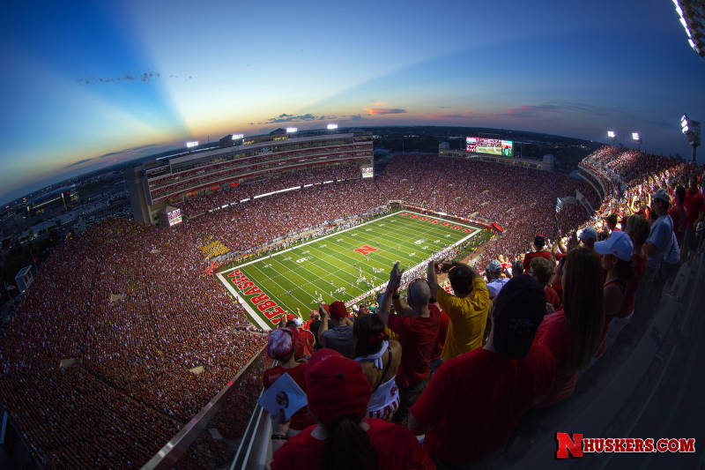
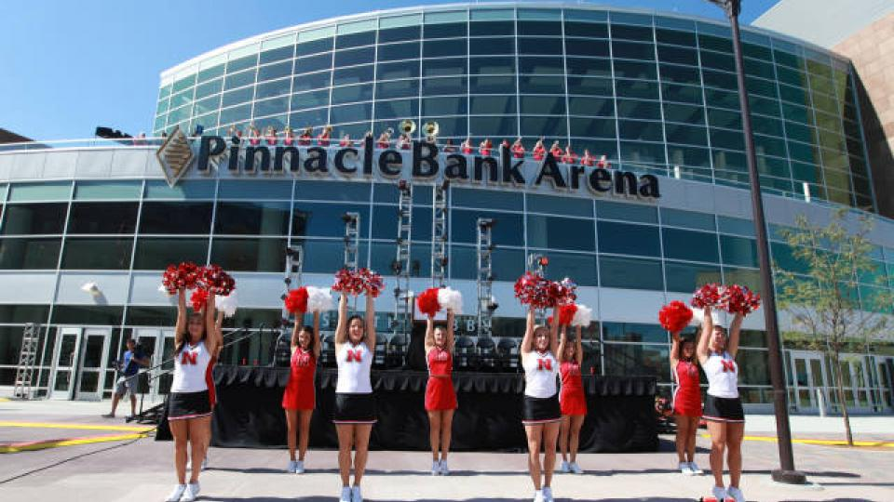
10 Reasons to Love Lincoln!
#1 U.S. City, Quality of Life
(The Gallup-Healthways Well-Being Index, 2012)
Lincoln Public Schools was ranked 2nd in quality of education in an eight-state area of the Midwest.
#8 best downtown
(Livability.com 2015)
#1 in America's Healthiest Small Cities
(Daily Finance 2014)
6th Best Place for Business and Careers
(Forbes, 2014)
7th best city for college students (among cities with 250,000–1,000,000 residents)
(American Institute for Economic Research, 2015)
Lincoln's health care costs are among the lowest in the nation
5th Safest American City
(Forbes, 2011)
Bicycle Friendly Community
(The League of American Bicyclists, 2012)
Top 20 - America's Thriving Cities
(The Daily Beast, 2013)

Slide 19
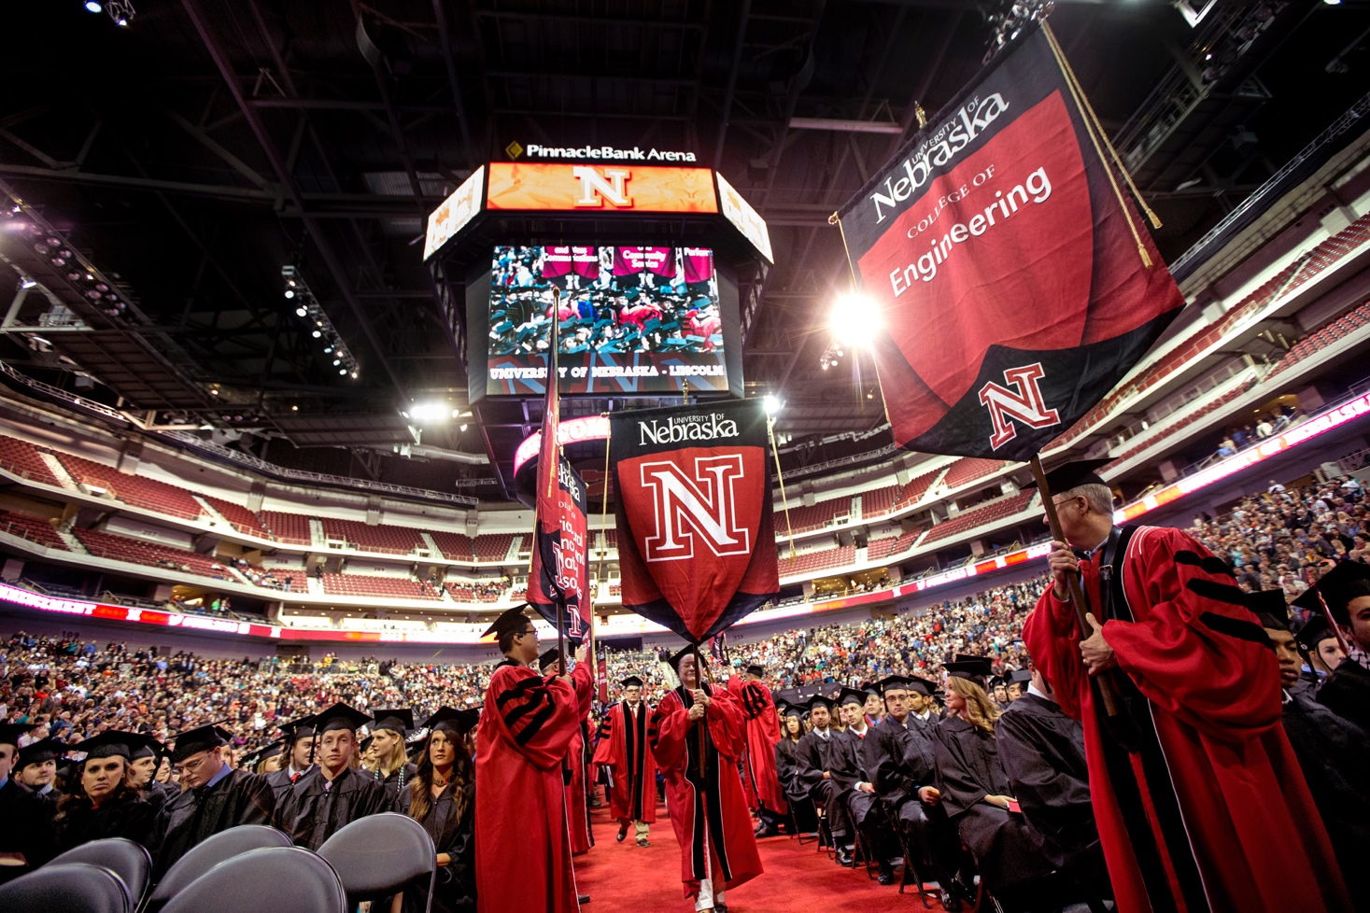
Apply Online
Deadlines:
For admission with financial consideration
Fall: January 15
Spring: September 1
For admission without financial consideration
Fall: March 1
Spring: October 1
http://cse.unl.edu/graduate-application-process

Slide 20
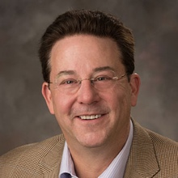
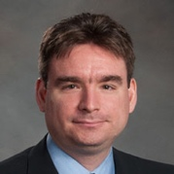
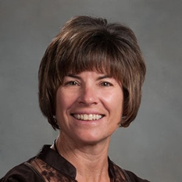
Contacts
If you have any questions of need more information contact:
Dr. Gregg Rothermel, Graduate Admissions
402-472-2184, grother@cse.unl.edu
Dr. Mehmet Can Vuran, Graduate Recruitment
402-472-5019, mcvuran@cse.unl.edu
LaRita Lang, Graduate Recruitment
402-472-3826, llang@cse.unl.edu

Slide 21
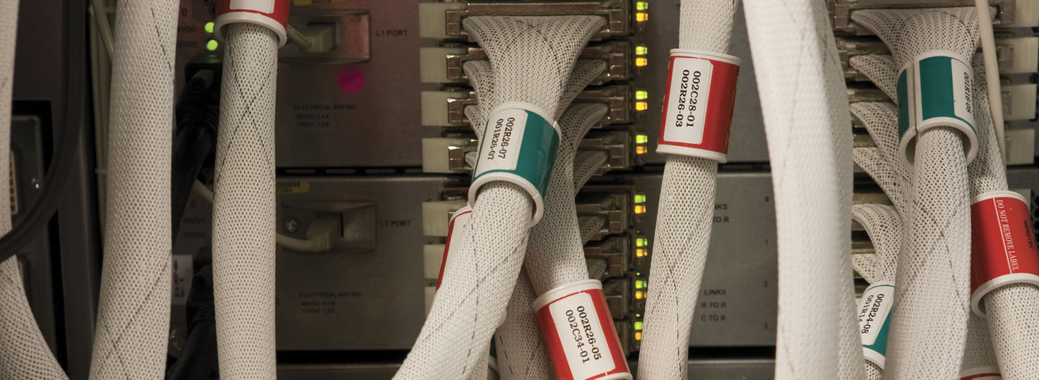
Thank You! Questions?

Slide 22
Backup slides

Slide 23
CSE Vision
To be broadly recognized as a top program in the US that
conducts state-of-the-art research in software engineering, systems, and informatics, and
educates students with the skill, knowledge, creativity, and vision to be leaders in defining the future of computing and information technology.
To be the “Innovators of the Cyberspace Age.”

Slide 24
CSE Vision
This vision includes:
Being a recognized leader in cyberinfrastructure research and cyberspace education,
Achieving a top 5 national ranking in software engineering,
Broadly integrating computing and information technology into education for all students and into research and scholarship for colleagues across the university,
Providing students with world-class computing infrastructure coupled to an innovative curriculum, and
An uncompromising pursuit of excellence

Slide 25
Graduate Student Information
100 Graduate Students
1/3 MS students
2/3 PhD students
27% domestic students
Over 60% of students supported as teaching or research assistants or with a fellowship
Full tuition waiver
http://cse.unl.edu/graduate#support

Slide 26
Graduation Information
Average number of degrees

